Slide 1
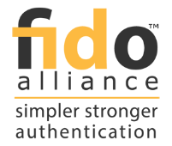
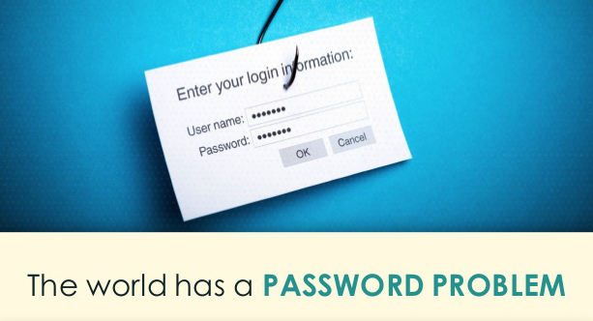
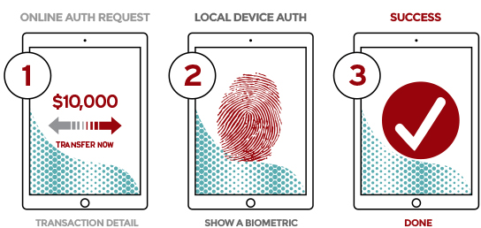
PSL FIDO SOLUTION
FIDO PASSWORDLESS EXPERIENCE
FIDO UAF standards help replace passwords with asymmetric cryptographic keys
FIDO facilitates local device authentication, user secrets are never stored on server
Passwords are non-intuitive to use
Credentials stored on the servers are vulnerable to attacks
Image source: https://fidoalliance.org/specifications/overview

Slide 2
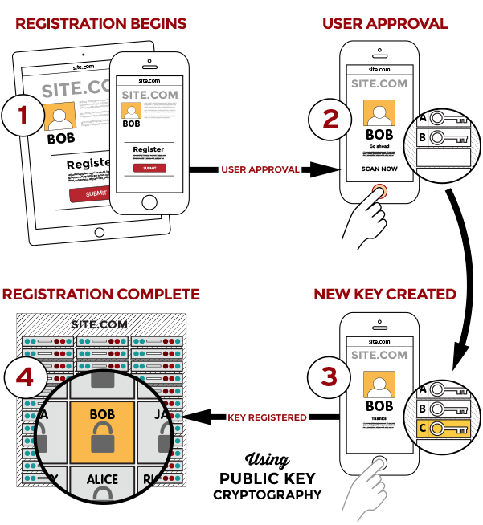
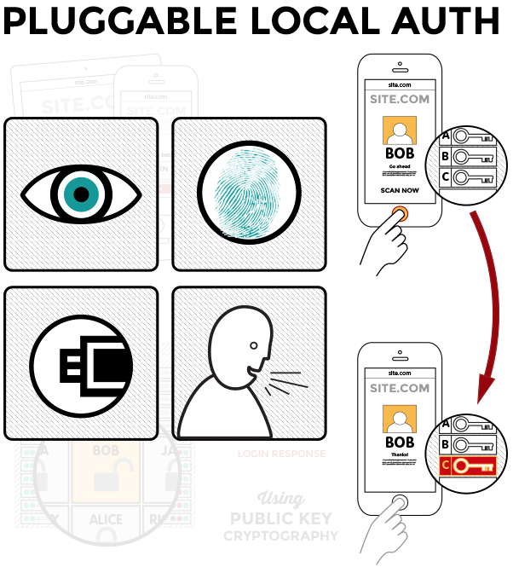
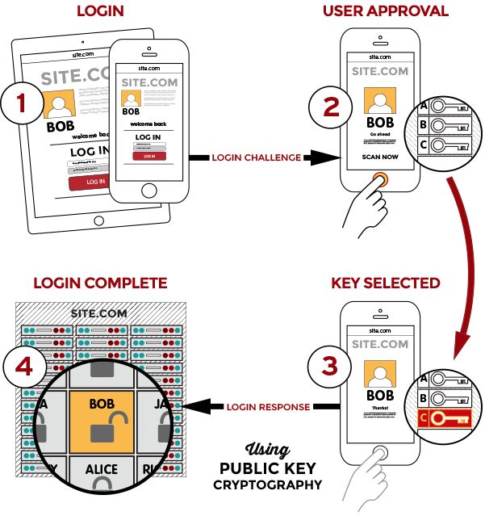
PSL FIDO SOLUTION
REGISTER WITH FIDO
PICK AUTHENTICATOR
LOGIN WITH FIDO
Image source: https://fidoalliance.org/specifications/overview

Slide 3
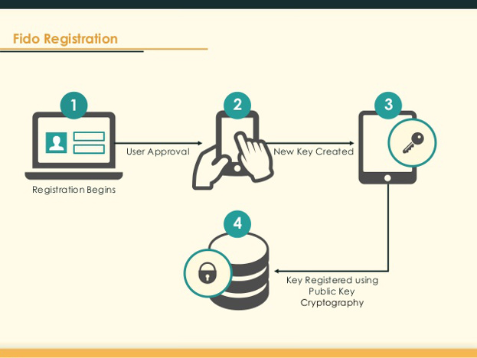
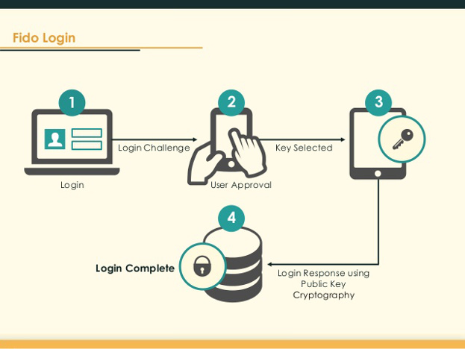
PSL FIDO SOLUTION
CREATE CREDENTIALS USING PSL FIDO
LOGIN WITH PSL FIDO CREDENTIALS
Install PSL FIDO smartphone application
Make credentials for existing accounts directly from account websites using PSL FIDO
PSL FIDO app supports multiple biometric authenticators such as fingerprint and face recognition
Login into existing accounts without password using PSL FIDO
At the time of login user provides consent using PSL FIDO smartphone application
Image source: https://fidoalliance.org/specifications/overview

